Slide 1

Lecture 7 (Day 7)

Slide 2
Topics Covered
Conditional Statements and loops
If Statement
Elif Statement
Else Statment
For and While Loops

Slide 3
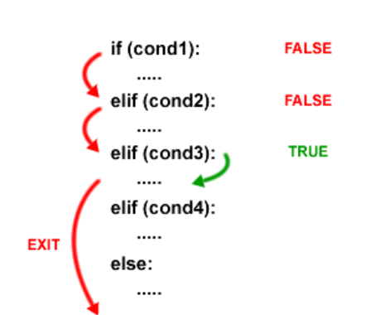
Conditional Statments
If, Elif, and else
These statments allow the program to take decisions depending on conditions.
If no condition is true, the program executes the condition in the else clause

Slide 4
Loops (For and While)
For loop
Used when you know how many times, to repeat
for i in range(5):
print("Iteration:", i)
Output = ?

Slide 5
Loops (For and While)
While loop
Used when you don’t know how many times to repeat, but you continue until a condition becomes False.
i = 1 while i <= 10: print(i) i += 3
Output = ?

Slide 6
Indentation
Python needs indentation because it uses it to structure code blocks
It improves readability, avoids confusion, and enforces consistency
Without indentation, Python wouldn’t know what belongs inside an if, for, or function.
if age >= 18:
print("You are an adult") # inside if
print("You can vote") # inside if
print("Program ends")

Slide 7
TASK
Write a Python program that asks the user for their age, and then uses if–elif–else to classify them as:
Child (age < 13)
Teenager (13–19)
Adult (20–59)
Senior Citizen (60 and above)

Slide 8
Code
age=int(input(" Enter your age please:")) if age <=13: print("You are Child") elif age>13 and age<=19: print("You are Teenager") elif age>20 and age<=59: print("You are Adult") else: print("You are Senior Citizen")

Slide 9
For Loop
For i in range (5),
Output = ?
For i in range (1,5)
Output = ?

Slide 10
For Loop
For i in range (5) = range (n)
range(n) generates numbers starting from 0 up to n-1
For i in range (5):
This means the loop will run 5 times
On the first iteration, i = 0
On the last iteration, i = 4

Slide 11
For Loop
For i in range (1,5) = range(start, stop)
Generates numbers starting from start up to stop – 1
For i in range (1, 5):
This means the loop will run 4 times
On the first iteration, i = 1
On the last iteration, i = 4

Slide 12
While true
This creates an infinite loop (it will keep running forever)
It only stops when a break statement is reached
Write a Python program that asks the user for numbers and prints them. Stop the loop when the user enters ‘0’ using while True:

Slide 13
While true
while True: num=int(input("Please enter a Number:")) if num==1: break print("You Entered:",num)
## print(f'You entered: {num}')

Slide 14
Use of Continue in Loop
The continue statement is used inside loops (for or while).
When Python sees continue, it skips the rest of the code in the current loop iteration and jumps to the next iteration immediately.
for i in range(1, 6):
if i == 3:
continue # skip printing 3
print("Number:", i)

Slide 15
Use of Continue in Loop
Write a Python program that prints numbers from 1 to 10, but skips printing multiples of 3.
Output:
1
2
4
5
7
8
10

Slide 16
Use of Continue in Loop
Write a Python program that prints numbers from 1 to 10, but skips printing multiples of 3.
for i in range(1, 11): if i % 3 == 0: continue print(i)

Slide 17
Using Else with Loops
The else block after a loop runs only if the loop finishes normally (i.e., without hitting a break).
If the loop is terminated by break, the else block is skipped.

Slide 18
Checking Prime Numbers
Write a Python program that checks if a number is prime
num = int(input('Enter a number: ')) if num > 1: for i in range(2, num): if num % i == 0: print(f'{num} is not prime') break else: print(f'{num} is prime') else: print(f'{num} is not prime')

Slide 19
Sum of Numbers Using Loops
Write a Python program that calculates the sum of numbers from 1 to 10 using a loop.
Output:
When i = 1 → total = 0 + 1 = 1
When i = 2 → total = 1 + 2 = 3
When i = 3 → total = 3 + 3 = 6

Slide 20
Sum of Numbers Using Loops
Write a Python program that calculates the sum of numbers from 1 to 10 using a loop
total = 0 for i in range(1, 11): total += i print(f'The sum of numbers from 1 to 10 is {total}')

Slide 21
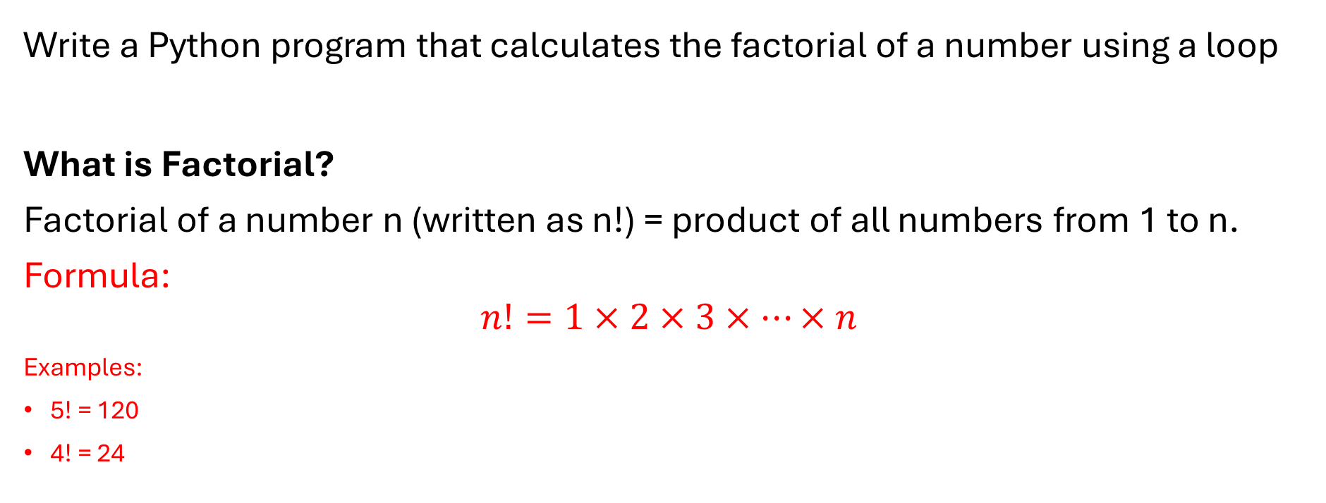
Factorial Calculation
Write a Python program that calculates the factorial of a number using a loop
What is Factorial?
Factorial of a number n (written as n!) = product of all numbers from 1 to n.
Formula:
$$n!=1×2×3×…×n$$
Examples:
5! = 120
4! = 24

Slide 22
Factorial Calculation
num = int(input('Enter a number: ')) factorial = 1 for i in range(1, num + 1): factorial *= i print(f'The factorial of {num} is {factorial}')

Slide 23
Reverse a String
Write a Python program that asks the user for a string and prints the string in reverse
Enter a String: Sharjeel
Output: leejrahs
Command:
s = input('Enter a string: ') print(f'The reverse of the string is {s[::-1]}')

Slide 24
Reverse a String
Enter a String: Sharjeel
Output: leejrahs
s[::-1] reads the string in reverse
s = input('Enter a string: ') print(f'The reverse of the string is {s[::-1]}')

